Slide 1
A look inside security at the New York Times.
or A media security primer for hackers
Presented by Jesse Krembs
Def Con 29, August 2021
Presented by Name Here
05/13/2020

Slide 2
Thank you
Notes:
Thank everyone at the times for their support
My girlfriend
It’s been a crazy few year A quick moment of retrospection Mr Rogers 15 seconds

Slide 3




My Journey
Def Con
Hacker Foundation
Internet Freedom Festival
New York Times
Notes:
IFF and the hard question?
They liked me they really liked me! Def con Hacker Foundation Work Work Internet Freedom Festival New York Times

Slide 4
The work of a news making organization is a very active part of being an engaged citizen
It’s not a job where “protecting shareholder value” is the primary concern.
The problems are complicated in both technical, logistical and human ways!
The people are great, and the work is evergreen.
But Why?
Civic Good
Shareholder Value
Hard Problems
Interesting People and fast paced

Slide 5
Hackers & Journalist
Journalists
Hackers
Information wants to be free
Notes:
They are an engaged audience

Slide 6
The New York Times by the Numbers.
169 Years Old
~4500 Employees
31 Foreign Bureaus
Just imagine the technical debt! But also the history!
Reporters! Printers! Admins! Developers! 1700+ Reporters! 200 overseas! 500+ developers!
Sixteen national bureaus, plus offices, and other facilities...oh yeah and work from home!
7.8+ Million Subscribers!
We move a lot of data
And we’re growing!
That’s a lot of subscribers! 100+ Million registered users! Avg weekly audience of 76 million.
150+ journalism pieces a day, also podcasts, and TV shows.
See that + sign it’s there for a reason.

Slide 7
Not I, we.
Infosec team, which is includes Security Operations, Intelligence, Education, AppSec, Secure Architecture, Incident Response, Continuity, plus our Risk and Compliance team.
Physical Security Teams both National and International.
Threat Response Team
System Admins, End User Support
Editors, Support Staff and Journalist.
And all the people that came before us.
Notes:
One small part of a larger team

Slide 8
Journalist Security for Hackers
Notes:
Journalist Security not journalism

Slide 9
Threats to Journalist
Harassment
Murder
Hacking
Deportation
Ad Pressure
Censorship
Self Censoring
Denied Access
Litigation/Lawfare
Political Pressure
Reputation Attacks
Notes:
We protect journalist and journalists protect journalism.
repressive governments are too often willing to kill journalists to keep their citizens in the dark about their actions.
66 journalists lost their lives reporting in 2020
1 died in Ukraine just recently while covering a public event.

Slide 10
Journalist security concerns
Physical Security
Information Security
Psycho- Social Security
Now more than ever the physical security concerns of journalist have increased.
Cyber security concerns have also increased, as technology plays a bigger and a bigger role.
This is an increasing recognition that the day to day stresses on journalist have possible negative outcomes.

Slide 11
Threats to Journalist
Harassment
Murder
Hacking
Deportation
Ad Pressure
Censorship
Self Censoring
Denied Access
Litigation/Lawfare
Political Pressure
Reputation Attacks
Notes:
The items highlighted in bold are really in the domain that an infosec team could address.

Slide 12
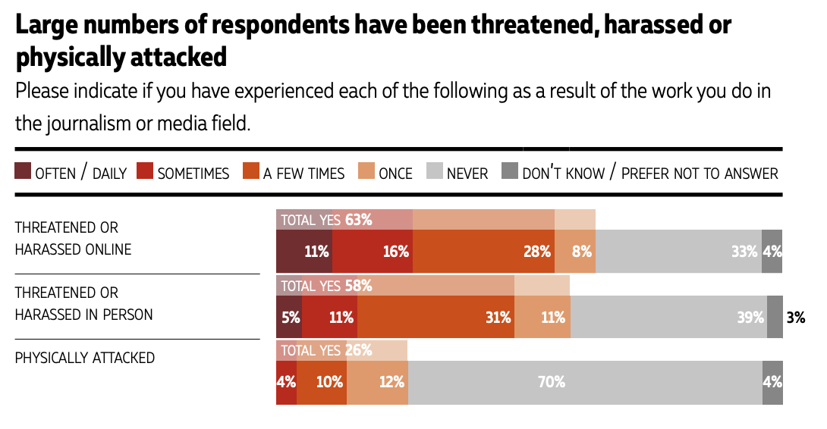
Harassment
A 2019 CPJ study found that 90% of respondents in the U.S. experienced safety issues/threats in the U.S.
Notes:
Thanks you Lucy @ CPJ 63% have been harassed online 58% have been harassed in person. 26% of journalist have been physically attacked.
Let this sink in!
AND IF you’re a female journalists these number go up! International Women's Media Foundation
Nearly two-thirds of women respondents say they have been threatened or harassed online at least once.
One in 10 respondents has experienced a death threat in the past year IWMF

Slide 13
Harassment and Social Media Presence
Having a strong social media presence for a journalist is a huge career asset.
Curating and maintaining this presence is work.
There will be harassment.
Most platforms are woefully unprepared to provide any real support regarding harassment.
Be thoughtful and considerate about what you post.
Notes:
Divide professional and personal!

Slide 14
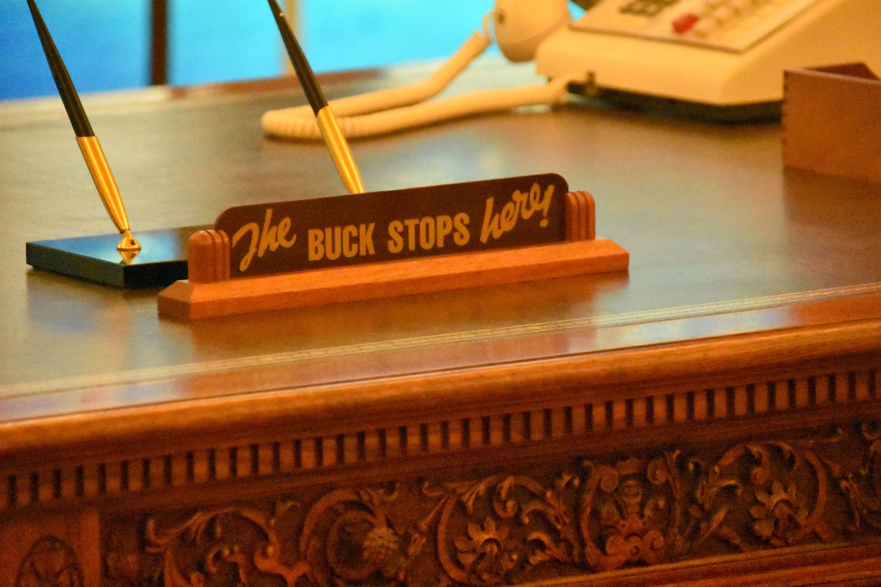
Journalist Security Responsibility
Notes:
If we look at the competing interests in the newsroom we see that ultimately the final say deciduous is with the journalist. The best we as a infosec team can do is prepare them with the best tools and knowledge available.

Slide 15
Training and Advisement
Notes:
Not the most high tech people But they are curious and persistent Make security tools usable!

Slide 16
Keep it actionable!
Notes:
Not the most high tech people But they are curious and persistent Make security tools usable!

Slide 17
The Five Basic Practices for Journalists
Strong Diverse Passwords → Password Managers Second Factor Authentication → Authenticator Apps and Hardware Tokens VPN → Company and Third Party Assets → Update Early, Update Often Secure Messaging → Signal
Notes:
Buty go where the sources is..

Slide 18
The Five Basics Practices for Journalists
Strong Diverse Passwords → Password Managers Second Factor Authentication → Authenticator Apps and Hardware Tokens VPN → Company and Third Party Assets → Update Early, Update Often Secure Messaging → Signal
Notes:
Buty go where the sources is..

Slide 19
The Five Basics Practices for Journalists
Strong Diverse Passwords → Password Managers Second Factor Authentication → Authenticator Apps and Hardware Tokens VPN → Company and Third Party Assets → Update Early, Update Often Secure Messaging → Signal
Notes:
Buty go where the sources is..

Slide 20
The Five Basics Practices for Journalists
Strong Diverse Passwords → Password Managers Second Factor Authentication → Authenticator Apps and Hardware Tokens VPN → Company and Third Party Assets → Update Early, Update Often Secure Messaging → Signal
Notes:
Buty go where the sources is..

Slide 21
The Five Basics Practices for Journalists
Strong Diverse Passwords → Password Managers Second Factor Authentication → Authenticator Apps and Hardware Tokens VPN → Company and Third Party Assets → Update Early, Update Often Secure Messaging → Signal
Notes:
Buty go where the sources is..

Slide 22
The Five Basics Practices for Journalists
Strong Diverse Passwords → Password Managers Second Factor Authentication → Authenticator Apps and Hardware Tokens VPN → Company and Third Party Assets → Update Early, Update Often Secure Messaging → Signal
Notes:
Buty go where the sources is..

Slide 23
The Five Basics Practices for Journalists
Strong Diverse Passwords → Password Managers Second Factor Authentication → Authenticator Apps and Hardware Tokens VPN → Company and Third Party Assets → Update Early, Update Often Secure Messaging → Signal
Notes:
Buty go where the sources is..

Slide 24
The Five Basics Practices for Journalists
Strong Diverse Passwords → Password Managers Second Factor Authentication → Authenticator Apps and Hardware Tokens VPN → Company and Third Party Assets → Update Early, Update Often Secure Messaging → Signal
Notes:
Divide your personal and private assets.

Slide 25
The Five Basics Practices for Journalists
Strong Diverse Passwords → Password Managers Second Factor Authentication → Authenticator Apps and Hardware Tokens VPN → Company and Third Party Assets → Update Early, Update Often Secure Messaging → Signal
Notes:
Buty go where the sources is..

Slide 26
The Five Basics Practices for Journalists
Strong Diverse Passwords → Password Managers Second Factor Authentication → Authenticator Apps and Hardware Tokens VPN → Company and Third Party Assets → Update Early, Update Often Secure Messaging → Signal
Notes:
Buty go where the sources is..
Divide your personal and professional assets.

Slide 27
The Five Basics Practices for Journalists
Strong Diverse Passwords → Password Managers Second Factor Authentication → Authenticator Apps and Hardware Tokens VPN → Company and Third Party Assets → Update Early, Update Often Secure Messaging → Signal
Notes:
But go where the sources is..

Slide 28
The Five Basics Practices for Editors
Communicate known security risks.
Listen for security concerns.
Connect reporters with support systems.
Have a regular and clear cadence of communication.
Be the example.
Notes:
Regular security communications with your reports P.S.I

Slide 29

But wait there's more!
Gather & Secure handling of source materials
Legal concerns
Tips and SecureDrop
Nation State Actors
Telecommunications security
Industrial Control Systems
Application Security
Cloud Architecture
Enterprise Security
Notes:
SecureDrop Freedom of The Press Foundation The grey business of the grey lady?

Slide 30
Hard Problems
Consistent language and presentation of security controls across social media platforms
Low resources high bandwidth telecommunications methods
Wireless Mesh networking for mobile reporting. Think Gotenna/Meshtastic that can send print ready photos or video.
Light weight opt-in mobile device management
Remote journalist check in security tools
Tor Network Speed → Run a proper relay or exit node.
Source media sanitization
Better tools for the searching and analysis of large mixed files sets.
External message handling tools for secure messaging platforms, for when your get 10X messages into your tip line, for Signal/Whatsapp/Telegram...
Notes:
Bellingcat has there own list of tools that need improvement..check out there website https://www.bellingcat.com/resources/2021/07/06/help-bellingcat-build-tools-for-open-source-investigators/

Slide 31
Get Involved?
Attend the Internet Freedom Festival or similar meetups!
Looking for work?
Digital Rights Job Board
Major and minor news outlets: Gannett-USAToday,WAPO,WSJ,NYT,Bloomberg, CNN,BBC,Reuters, AP, Or you local news org!
Work with NGO working in this space
CPJ,RSF,IFJ,IWMF,FPF
Notes:
Committee to protect journalists reporters sans frontieres International Federation of Journalists
International Women's Media Foundation Freedom of the press foundation

Slide 32
Q&A? @jessekrembs

Slide 33
So let us today drudge on about our inescapably impossible task of providing every week a first rough draft of history that will never really be completed about a world we can never really understand … Phil Graham
Notes:
We don’t always get it right! Misinformation is false, inaccurate, or misleading information that is communicated regardless of an intention to deceive. Disinformation is false or misleading information that is spread deliberately to deceive. This is a subset of misinformation
The information presents in a news article is intend to be accurate and provide balanced context.
But!
We don’t get it right. But we try.

Slide 34
News Vs Opinion Editorial Vs Op-ed vs commentary vs Letters to the editor
Notes:
News story: An account of events prepared by a reporter or team of reporters. It is our best effort to present true facts in real time Editorial: An opinion about a matter of public interest or policy that is written by an editorial board. Editorials are not unbiased; they represent the paper's advocacy for insights and ideas that cannot be expressed in news reporting, in which competing ideas are typically treated as equal. Column: Combines reporting, storytelling and commentary to make a point. Unlike reporters, columnists are allowed to include their opinions. Columnists in the Union-Tribune are identified clearly to set them apart from news reporters. News analysis: An interpretation of news events using context, trends and data often seen in other media. Because they cross into opinion, these rarely are used in the Union-Tribune's news sections. Letter to the editor or comment: A reader's written opinion that is submitted by mail or email or posted in response to a story in our paper or on our website. Op-ed or commentary: An essay that presents the opinion or perspective of someone with insight on the news, usually a stakeholder or expert in the field.

Slide 35
Copy
Title: A media security primer for hackers.
Abstract : This talk will cover the unique threats and challenges of working in information security for a news organization. Some best practices for journalists, hard technical problems facing media security, and how hackers can get involved. This talk is for both hackers and journalists.
Bio: Jesse Krembs is a long term Def Con goon and now a staff information security analyst at The New York Times. He provides security support to journalists, and staff globally. He’s had a variety of jobs over his lifetime, working as a bike messenger, a caterer, a webmaster for a brewery, a wireless engineer, and doing even security work for the phone company. He leads the Def Con 4 X 5K, and climbs rocks for fun.

